Slide 1





SMART
INSURANCE
PROCESSING
Presented by Harishmitha S V

Slide 2



Introduction
Smart Insurance Processing, a cutting-edge collaboration between UiPath and OpenAI. Through advanced AI technology, we seamlessly extract personal details from certificates, streamlining insurance processes with unparalleled efficiency. With automated data storage in Excel, manual input becomes a thing of the past, ensuring accuracy and reliability. Our innovative solution transforms insurance form filling, empowering users with time-saving capabilities and enhancing overall productivity. Experience the future of insurance processing today with our revolutionary integration of UiPath and OpenAI.

Slide 3
EXISTING SYSTEM
The current insurance processing system relies heavily on manual data entry, leading to inefficiencies and errors. Human operators manually extract personal details from certificates, introducing delays and inaccuracies. This process is time-consuming and prone to human error, resulting in inconsistencies in data entry. Additionally, the lack of automation increases the likelihood of data entry duplication and data loss. The absence of advanced AI technologies limits the system's ability to adapt to various certificate formats and languages. Moreover, the reliance on manual labor escalates operational costs and hampers scalability. Overall, the existing system struggles to meet the demands of modern insurance processing, necessitating a more efficient and automated solution.

Slide 4
PROPOSED SYSTEM
Leveraging UiPath and OpenAI, our proposed system streamlines insurance processing by autonomously extracting personal details from certificates. This data is seamlessly transferred to an Excel sheet for organized storage. Subsequently, the insurance form is automatically populated with the extracted information, enhancing efficiency and accuracy in insurance processing workflows.
Moreover, our system incorporates advanced natural language processing capabilities from OpenAI to enhance data extraction accuracy and adaptability. By utilizing cutting-edge AI algorithms, the system intelligently parses various certificate formats, ensuring robust performance across diverse document types. This integration of UiPath's automation capabilities with OpenAI's language processing prowess empowers seamless, ultimately optimizing resource utilization

Slide 5
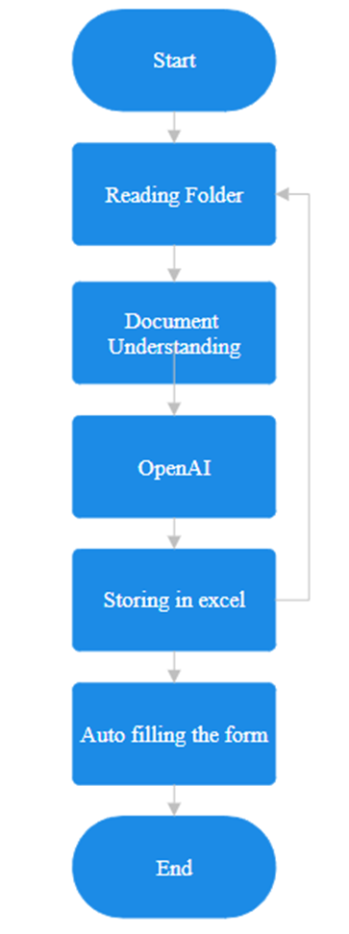
FLOW OF THE PROJECT
Data Extraction from Personal Certificates
Automatic Filling of Insurance Forms
Integration with OpenAI for Query Handling
Response Delivery
Feedback and Iteration
Monitoring and Maintenance
User Interaction and Input Collection
Natural Language Understanding and Processing
Mode Selection for Response Delivery
Error Handling and Exception Management

Slide 6


FRONTEND
UIPATH STUDIO
EXCEL
OPENAI
UiPath Studio automates the extraction of personal details from certificates and populates the insurance form, enhancing efficiency in data processing tasks.
Excel serves as a centralized database for storing the extracted data, ensuring organized and accessible records for future reference in the insurance processing workflow.
The insurance form acts as the recipient of the extracted data, facilitating the seamless completion of insurance applications with minimal manual input, thereby streamlining the overall process.

Slide 7

Background
UIPATH ORCHESTRATOR
OPENAI
UiPath Orchestrator serves as the backbone of your automation framework, orchestrating the seamless execution of tasks across your insurance processing system. It offers centralized control, scheduling, and monitoring capabilities, ensuring efficient management of automated workflows.
OpenAI augments your system's intelligence by providing advanced natural language processing capabilities. It enables accurate extraction of data from personal certificates, enhances data enrichment, and ensures adaptability to diverse document formats, thereby optimizing the efficiency and accuracy of your insurance processing workflow.

Slide 8

ACTIVITIES USED
Data Extraction
Excel Automation
Form Filling
Email Automation
Message Automation
Phone Call Automation
UiPath.Excel.Activities
UiPath.Mail.Activities
UiPath.UIAutomation.Activities
UiPath.System.Activities
UiPath.Form.Activities (if applicable)
UiPath.Orchestrator.Client (if integrated with Orchestrator)

Slide 9
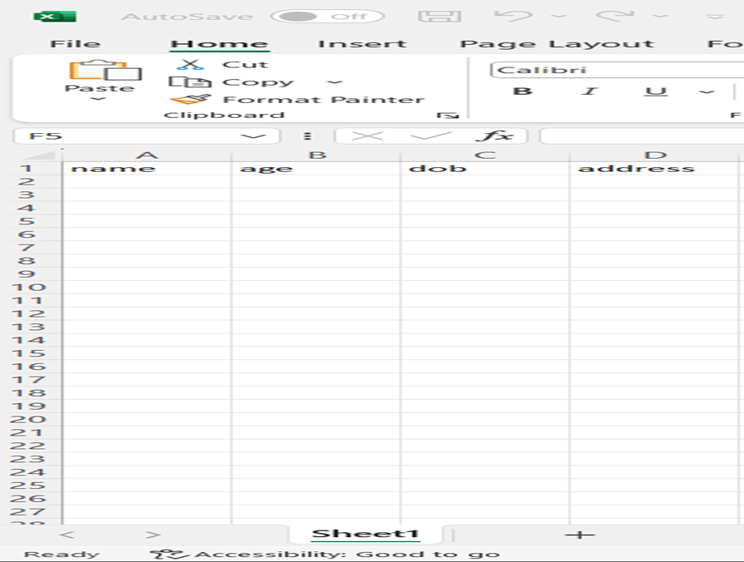
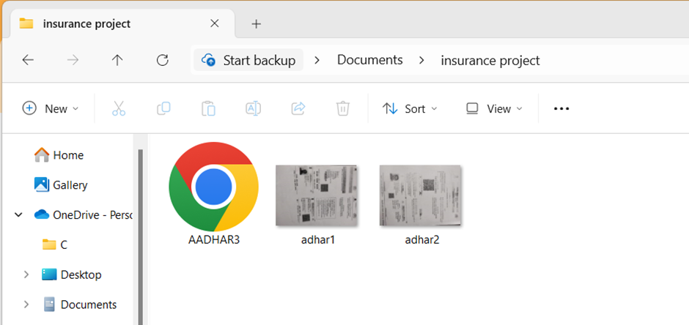
INPUT

Slide 10
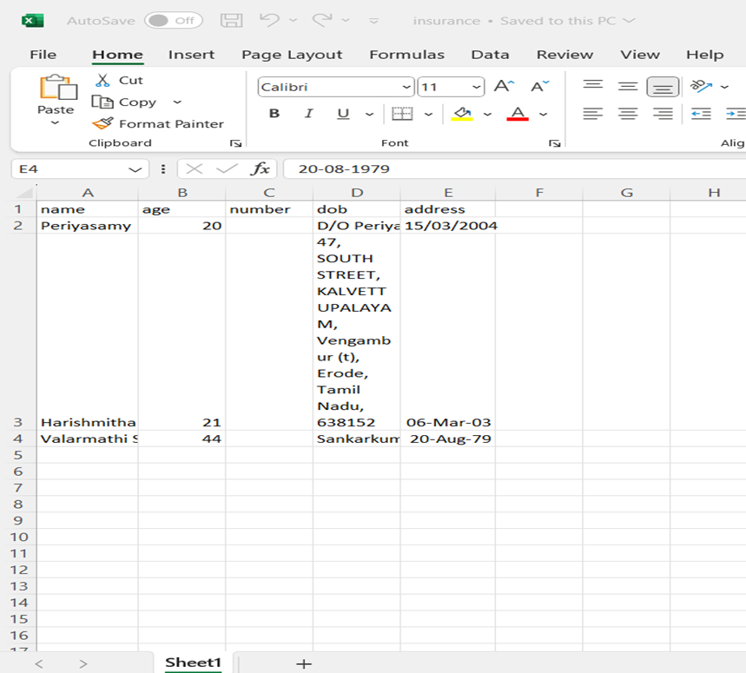
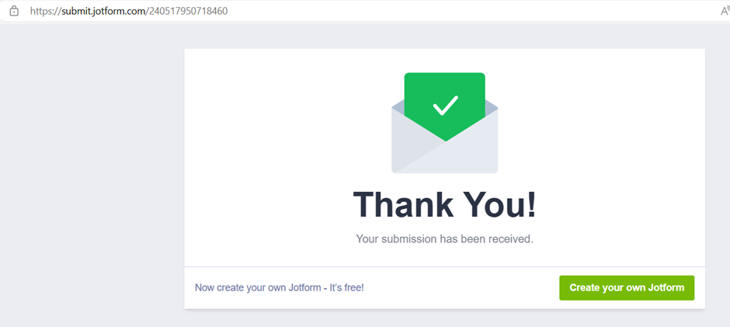
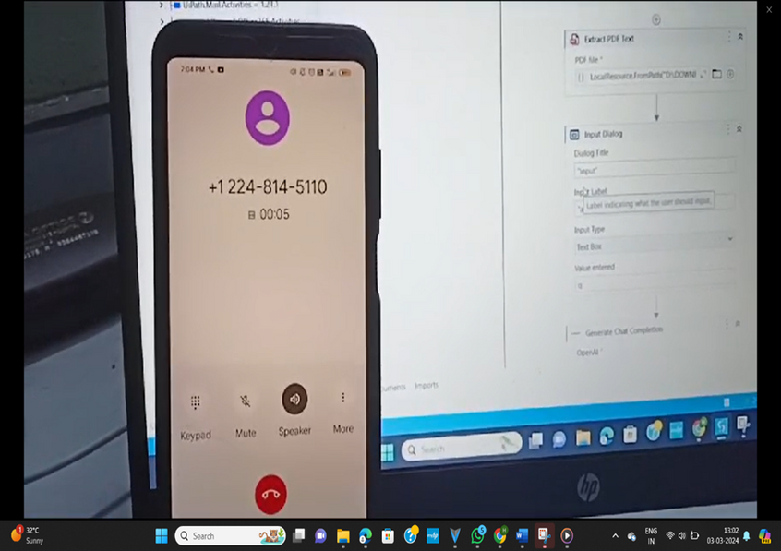
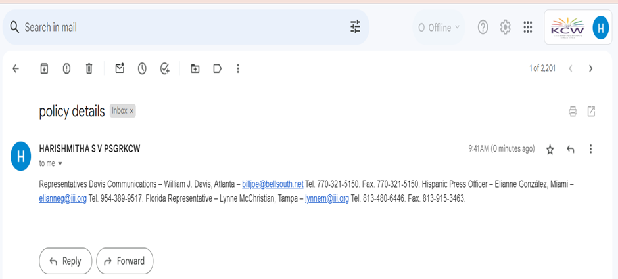
OUTPUT

Slide 11
EXECUTION VIDEO
https://drive.google.com/file/d/1fBs9SPZQWg8WOVuFBAr_FHC1T_-qykbI/view?usp=sharing
https://drive.google.com/file/d/1t5t_1RJ5sWXpBY9PfJta7Lf_Sdaunedq/view?usp=sharing
https://drive.google.com/file/d/1lj4PXTZ5DlPyIe17s--LyaX2L8NSl7jG/view?usp=sharing
https://drive.google.com/file/d/1kRIGSVXQFN1AqLqsN2q0FKVbUfGuejpV/view?usp=sharing

Slide 12
CONCLUSION
In conclusion, the Smart Insurance Processing project leverages UiPath and OpenAI to automate the insurance process seamlessly. By extracting data from personal certificates and populating insurance forms, it streamlines administrative tasks efficiently. The integration of AI enables users to inquire about their insurance status through various communication modes, enhancing accessibility and customer satisfaction. This innovative solution not only reduces manual effort but also improves response time and communication effectiveness, marking a significant advancement in insurance processing technology.

Slide 13

Thank
You

